Slide 1
Deadlocks in DBMS

Slide 2
What is a Deadlock ?
A deadlock is a situation in which two or more threads are waiting for a resource held by another thread and can cause the entire database management system to become unresponsive.
Simply put, when two or more threads attempt to access the same resource and wait indefinitely for it to be released, it causes them to be stuck in an infinite loop with no result.
Eg: T1 and T2 are two processes which control tables ‘Student’ and ‘Grade’ respectively.
Notes:
A deadlock occurs when two or more threads attempt to access the same resource and wait indefinitely for it to be released. This deadlock leads to the threads being stuck in an infinite loop, unable to proceed. The entire database management system can become unresponsive as a result

Slide 3
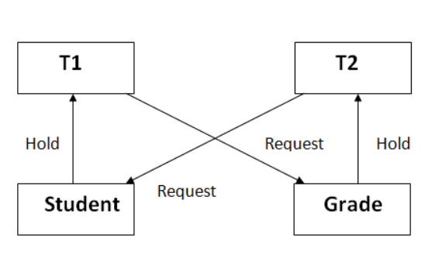
Here, T1 controls table ‘Student’ and T2 controls ‘Grade’. If any of the either processes require any row/column from the other table, both will come to a halt and remain at standstill.

Slide 4
How to avoid Deadlocks ?
Deadlock avoidance mechanism is used to detect any deadlock situation in advance.
There are 2 methods by which we can avoid deadlocks -
1. Detecting a deadlock (Smaller databases)
2. Preventing a deadlock (Larger databases)

Slide 5
Some common techniques that can be used to avoid deadlocks include:
Lock ordering - Transactions can be required to acquire locks in a specific order to avoid deadlocks.
Timeouts - Transactions can be given a limited time to acquire locks, and if they cannot, they are aborted to avoid a deadlock.
Lock escalation - Transactions can be automatically upgraded to a higher level lock to prevent deadlocks.

Slide 6
Detecting a Deadlock
In a database, when a transaction waits indefinitely to obtain a lock, the DBMS detects whether the transaction is involved in a deadlock or not.
Wait for Graph is a technique used to detect deadlocks. In this method, a graph is created based on the transaction and their lock. If the created graph has a cycle or closed loop, then there is a deadlock.
It is maintained by the system for every transaction which is waiting for some data held by the others. The system keeps checking the graph if there is any cycle in the graph.

Slide 7
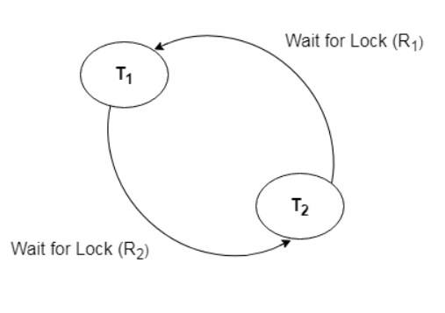

Slide 8
Preventing a Deadlock
Preventing deadlocks involves designing the database system in a way that minimizes the chances of deadlocks occurring. Some techniques that can be used to prevent deadlocks include:
1. Simplifying transactions - Transactions should be kept as simple as possible to reduce the likelihood of a deadlock.
2. Reducing lock contention - Lock contention can be reduced by using indexing and partitioning to reduce the number of locks that need to be acquired.
3. Using optimistic concurrency control - Optimistic concurrency control allows multiple transactions to modify the same data concurrently without acquiring locks, which can reduce the likelihood of a deadlock.

Slide 9
4. Wait and Die: A transaction requests for a resource which is already held with a conflicting lock by another transaction then the DBMS simply checks the timestamp of both transactions. It allows the older transaction to wait until the resource is available for execution or it kills the younger transaction if the older transaction has the resource.
5. Wound Wait: If the older transaction requests for a resource which is held by the younger transaction, then older transaction forces younger one to kill the transaction and release the resource. After the minute delay, the younger transaction is restarted but with the same timestamp.If the older transaction has held a resource which is requested by the Younger transaction, then the younger transaction is asked to wait until older releases it.

Slide 10
CONCLUSION
In conclusion, deadlocks can be a serious problem in a DBMS, but they can be detected, avoided, and prevented by using appropriate techniques and strategies. It is important to design the database system and transactions carefully to minimize the chances of a deadlock occurring.

